Slide 1

Bank Marketing
Grateful for your support: Eng / Abdelrahman Gaber

Slide 2
introduction
Bank Marketing dataset is collected from direct marketing campaign of a bank institution.
Marketing campaign can be understood as phone calls to the clients to convince them accept to make a term deposit with their bank.
After each call, they are being noted as to no - being the client did not make a deposit and yes - being the client on call accepted to make a deposit.
The purpose of this project is to predict if the client on call would accept to make a term deposit or not based on the information of the clients.

Slide 3
Goals
Increase customer acquisition through targeted marketing efforts.
Reduce customer churn and enhance retention rates.
Improve marketing campaign effectiveness by targeting the right audience.
Maximize marketing ROI (return on investment) by optimizing resource allocation.

Slide 4

feature
Age
Job
Marital
Education
Default
Balance
Housing
Loan
Contact Day
Month
Duration
Campaign
Pdays
Previous
Poutcome
Deposit

Slide 5
Project Workflow
Data Collection
Data Preprocessing.
Exploratory Data Analysis (EDA).
Customer Segmentation
Data Analysis.
machine learning model
Deployment

Slide 6
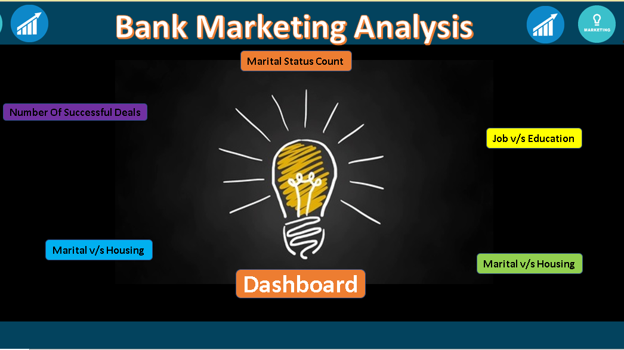

Slide 7
Recommendation
Targeted Marketing Campaigns: Segment customers and tailor campaigns based on their preferences.
Enhanced Customer Personalization: Use data to provide personalized product recommendations and communications.
Improve Customer Engagement: Implement strategies to increase customer interaction and loyalty.
Optimize Timing and Frequency of Outreach: Send marketing messages at the right time and frequency.

Slide 8

Thanks
Aml Kamal

